Slide 1

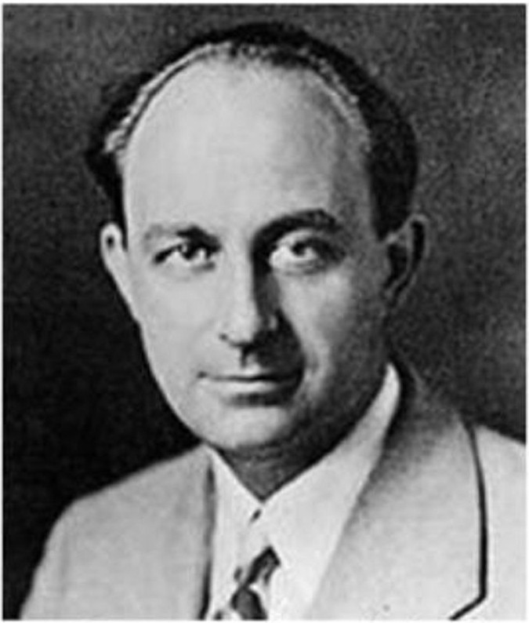
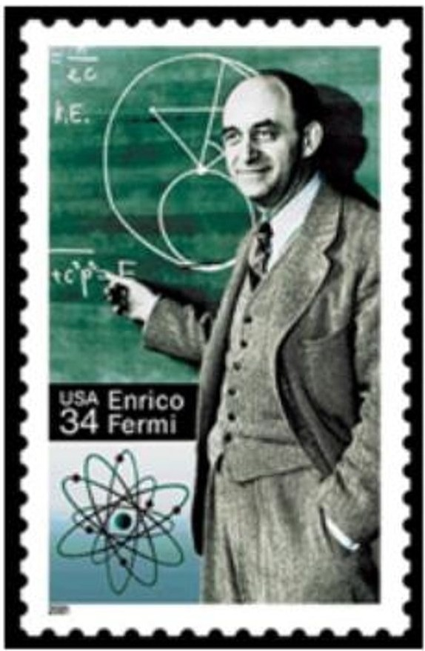
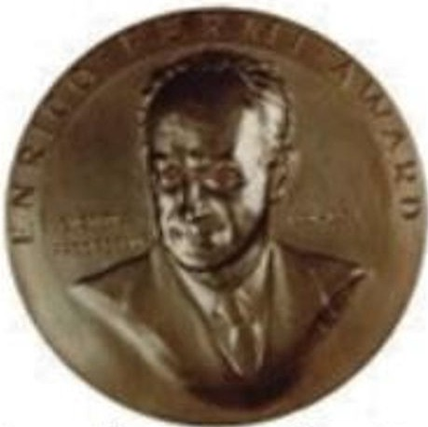


Fermi Problems...?
Named after the Italian­ American University of Chicago professor and noted 20th century physicist and Nobel Prize-winner
Fermi problems are math word problems that require making educated guesses using estimation skills and prior knowledge
One super smart dude..!
Fermi problems are solved by breaking the complex problem into smaller ones and using estimation skills to continuously refine your answer
...has his own prize from the
Atomic Energy Commission

Slide 2

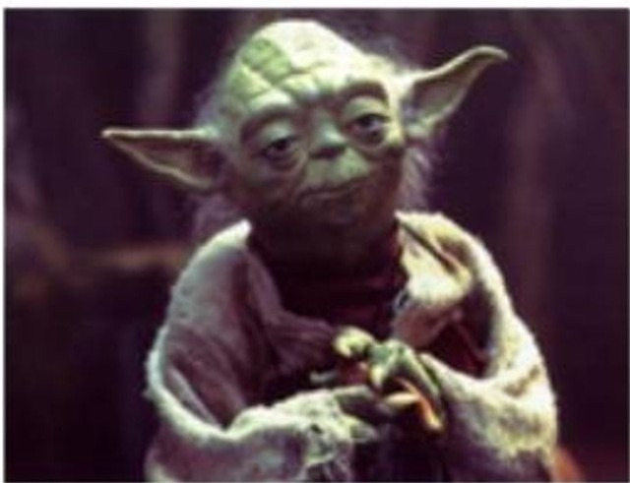
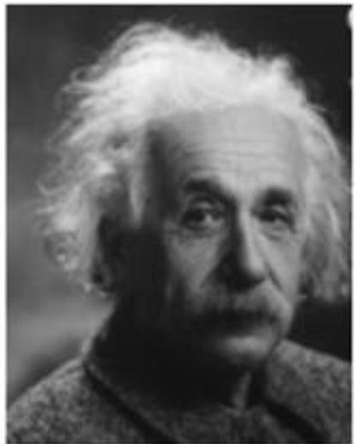


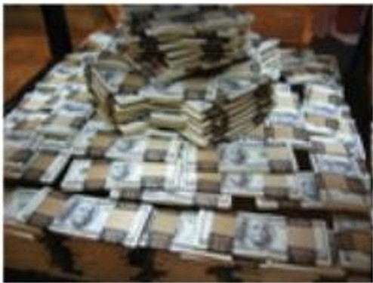
and what's so much fun about them... ?
Fermi problems
require imagination
Fermi problems will 1orce" you to think differently
Fermi problems are good exercise for your
brain
Fermi problems often don't have an exact
You can even create your own Fermi problems and stump your parents!
Fermi problems will help make you rich and famous!

Slide 3

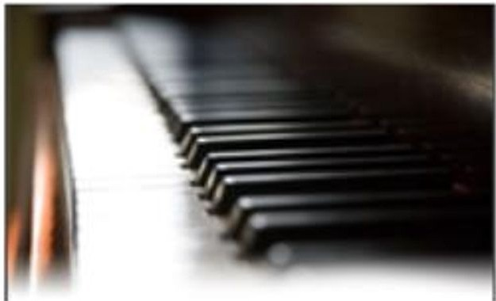
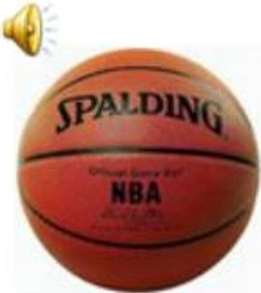
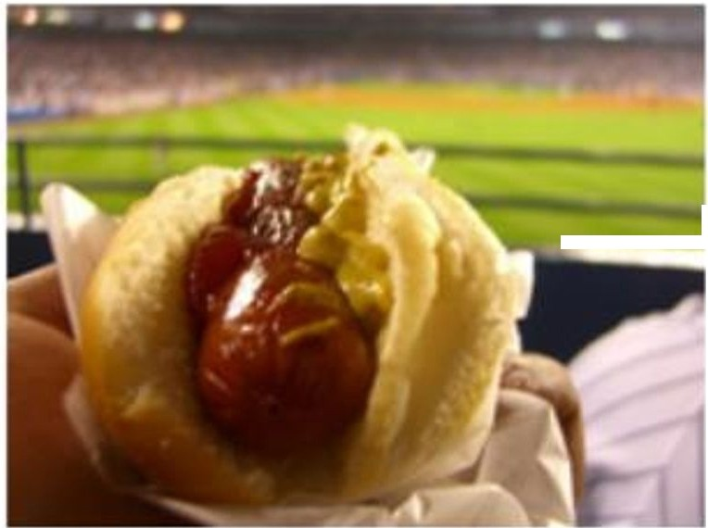
Let¹s take a look at some examples of Fermi
Problems...
II. How many piano tuners are there in the
city of Chicago?
I. How many basketballs would fill this classroom?
I Ill. How many hot dogs will be sold at Yankee Stadium this season?

Slide 4


Slide 5
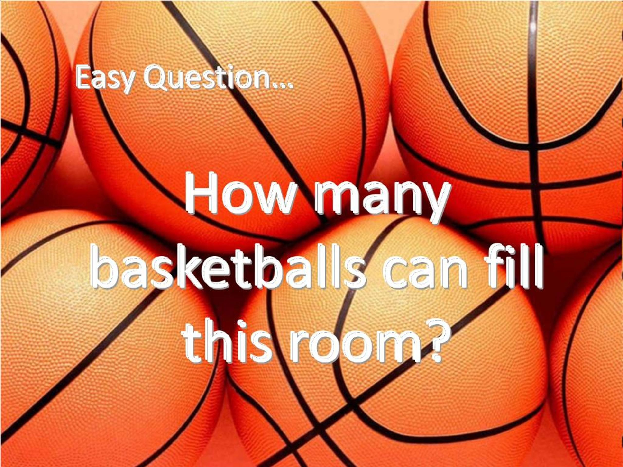

Slide 6


Slide 7
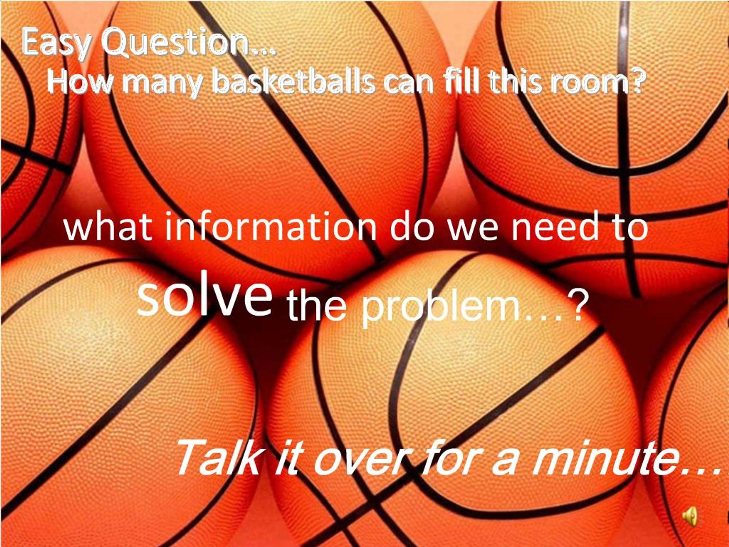

Slide 8
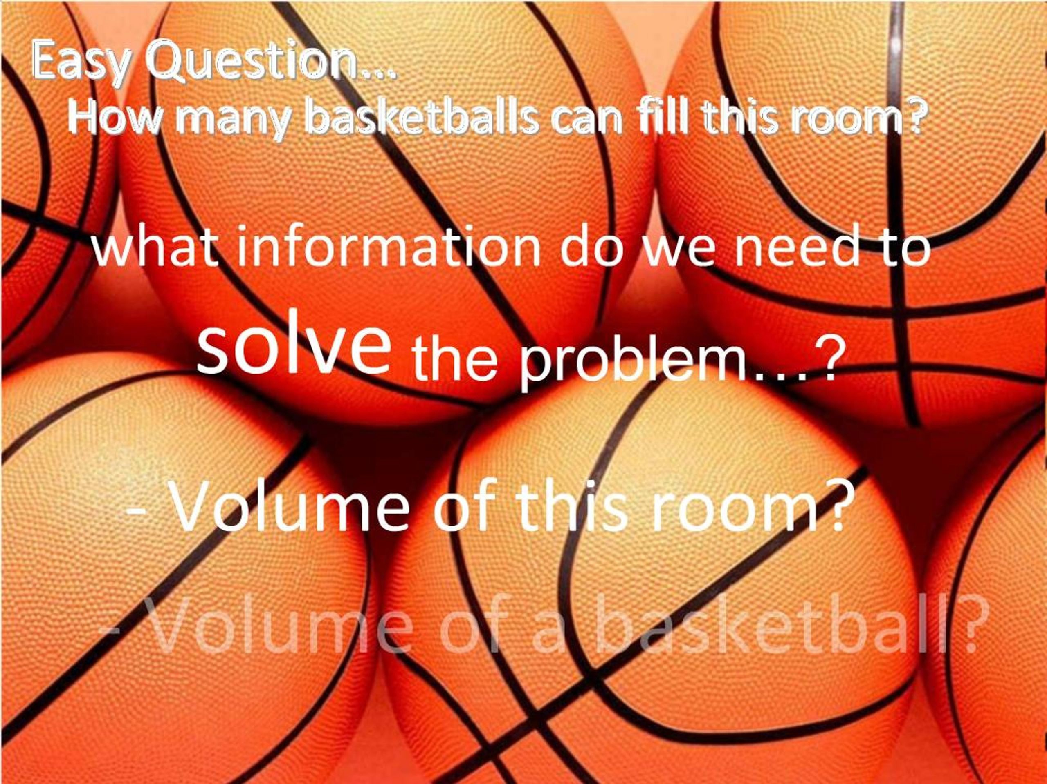

Slide 9


Slide 10
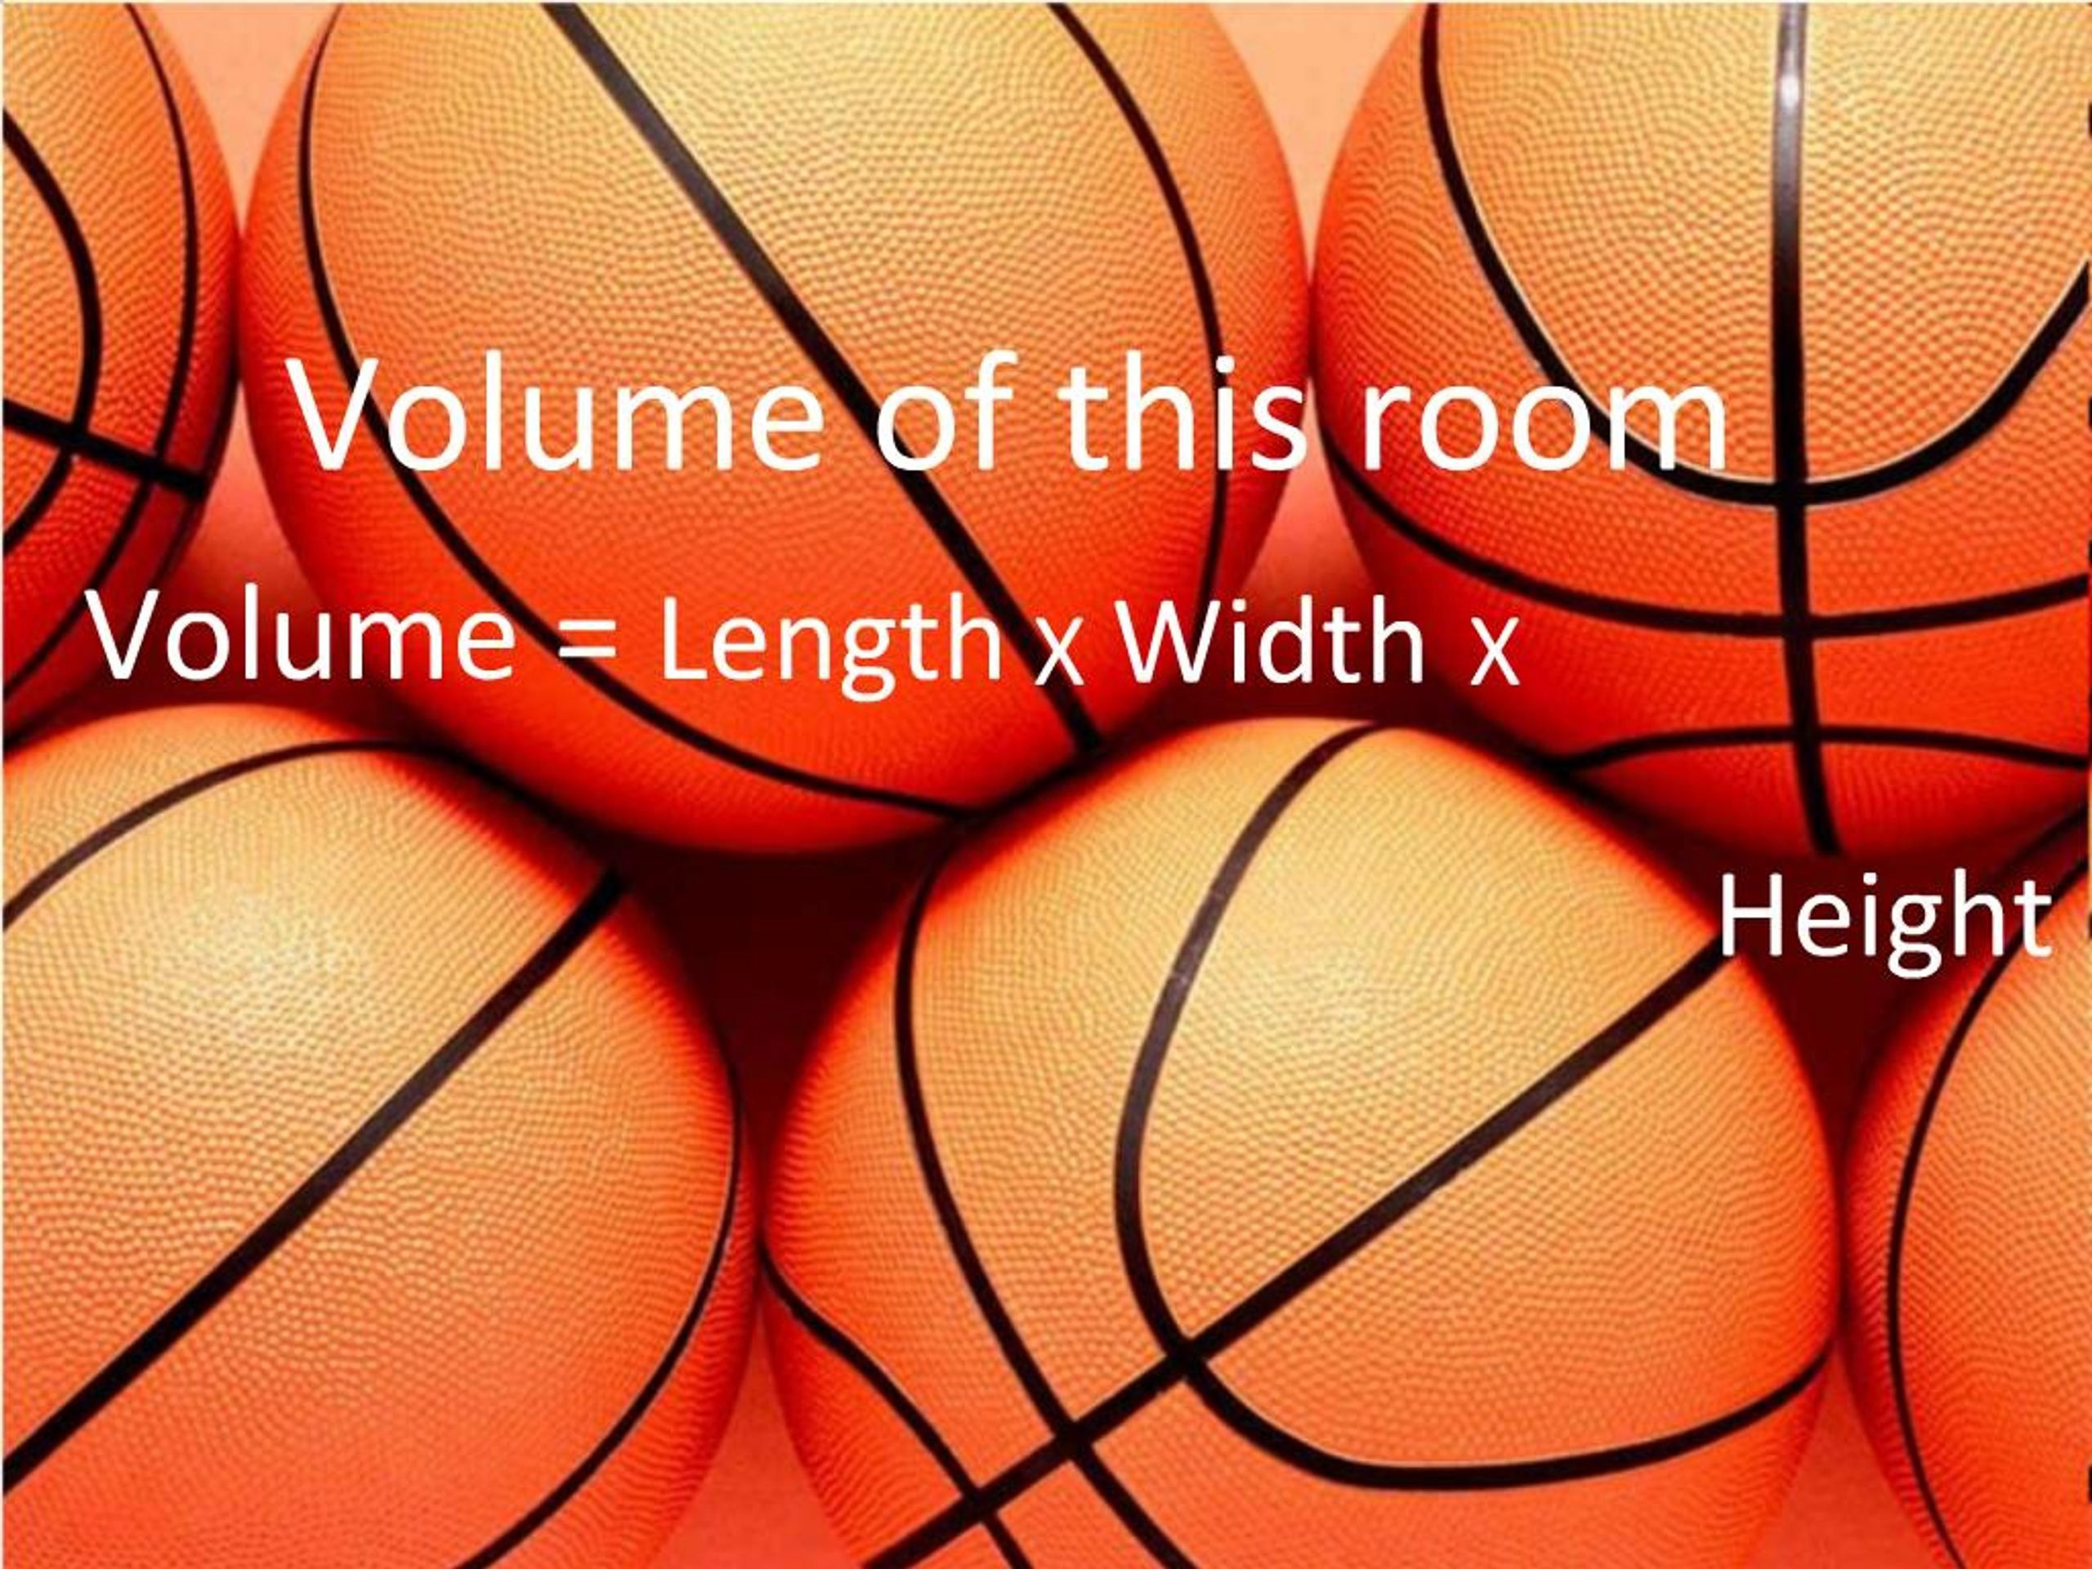

Slide 11
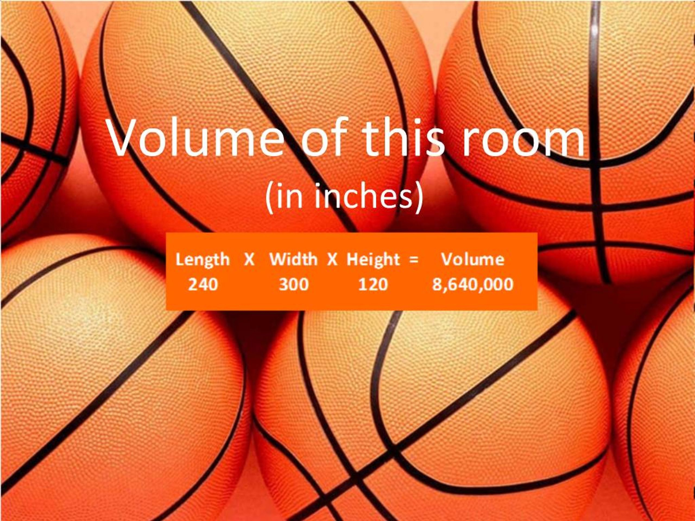

Slide 12
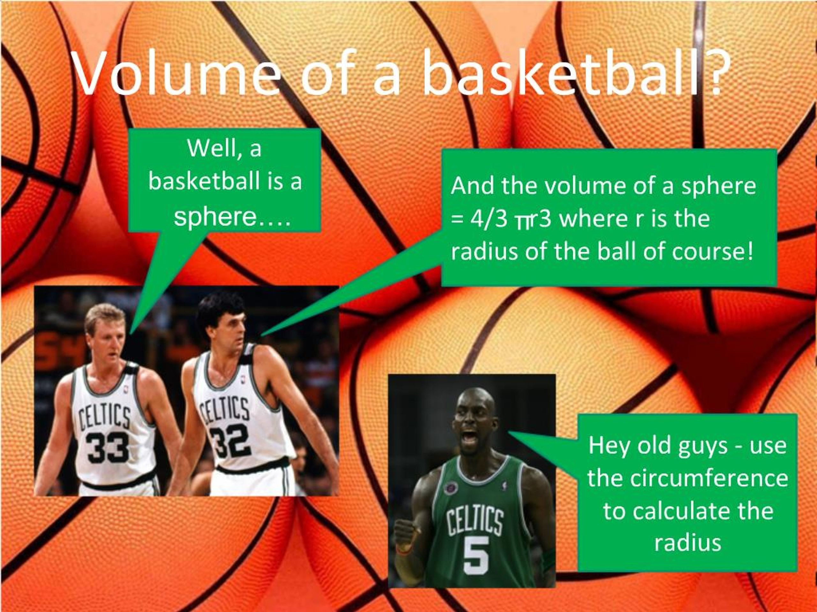

Slide 13
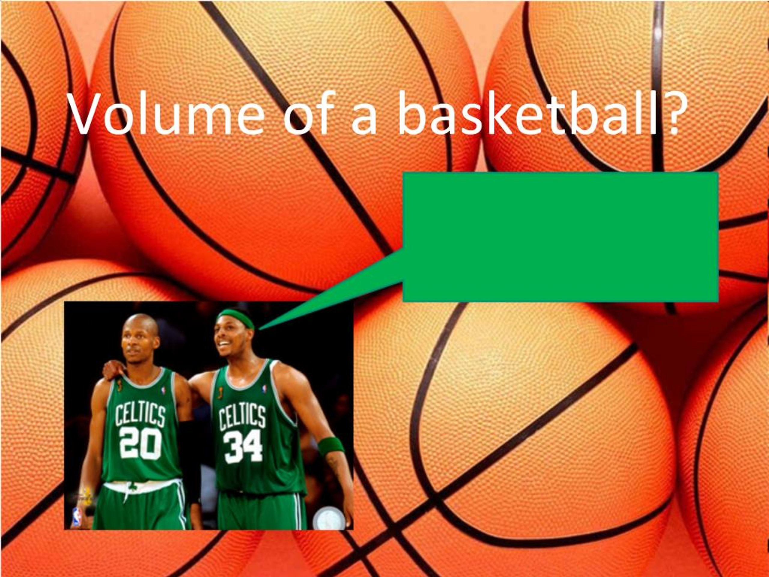

Slide 14
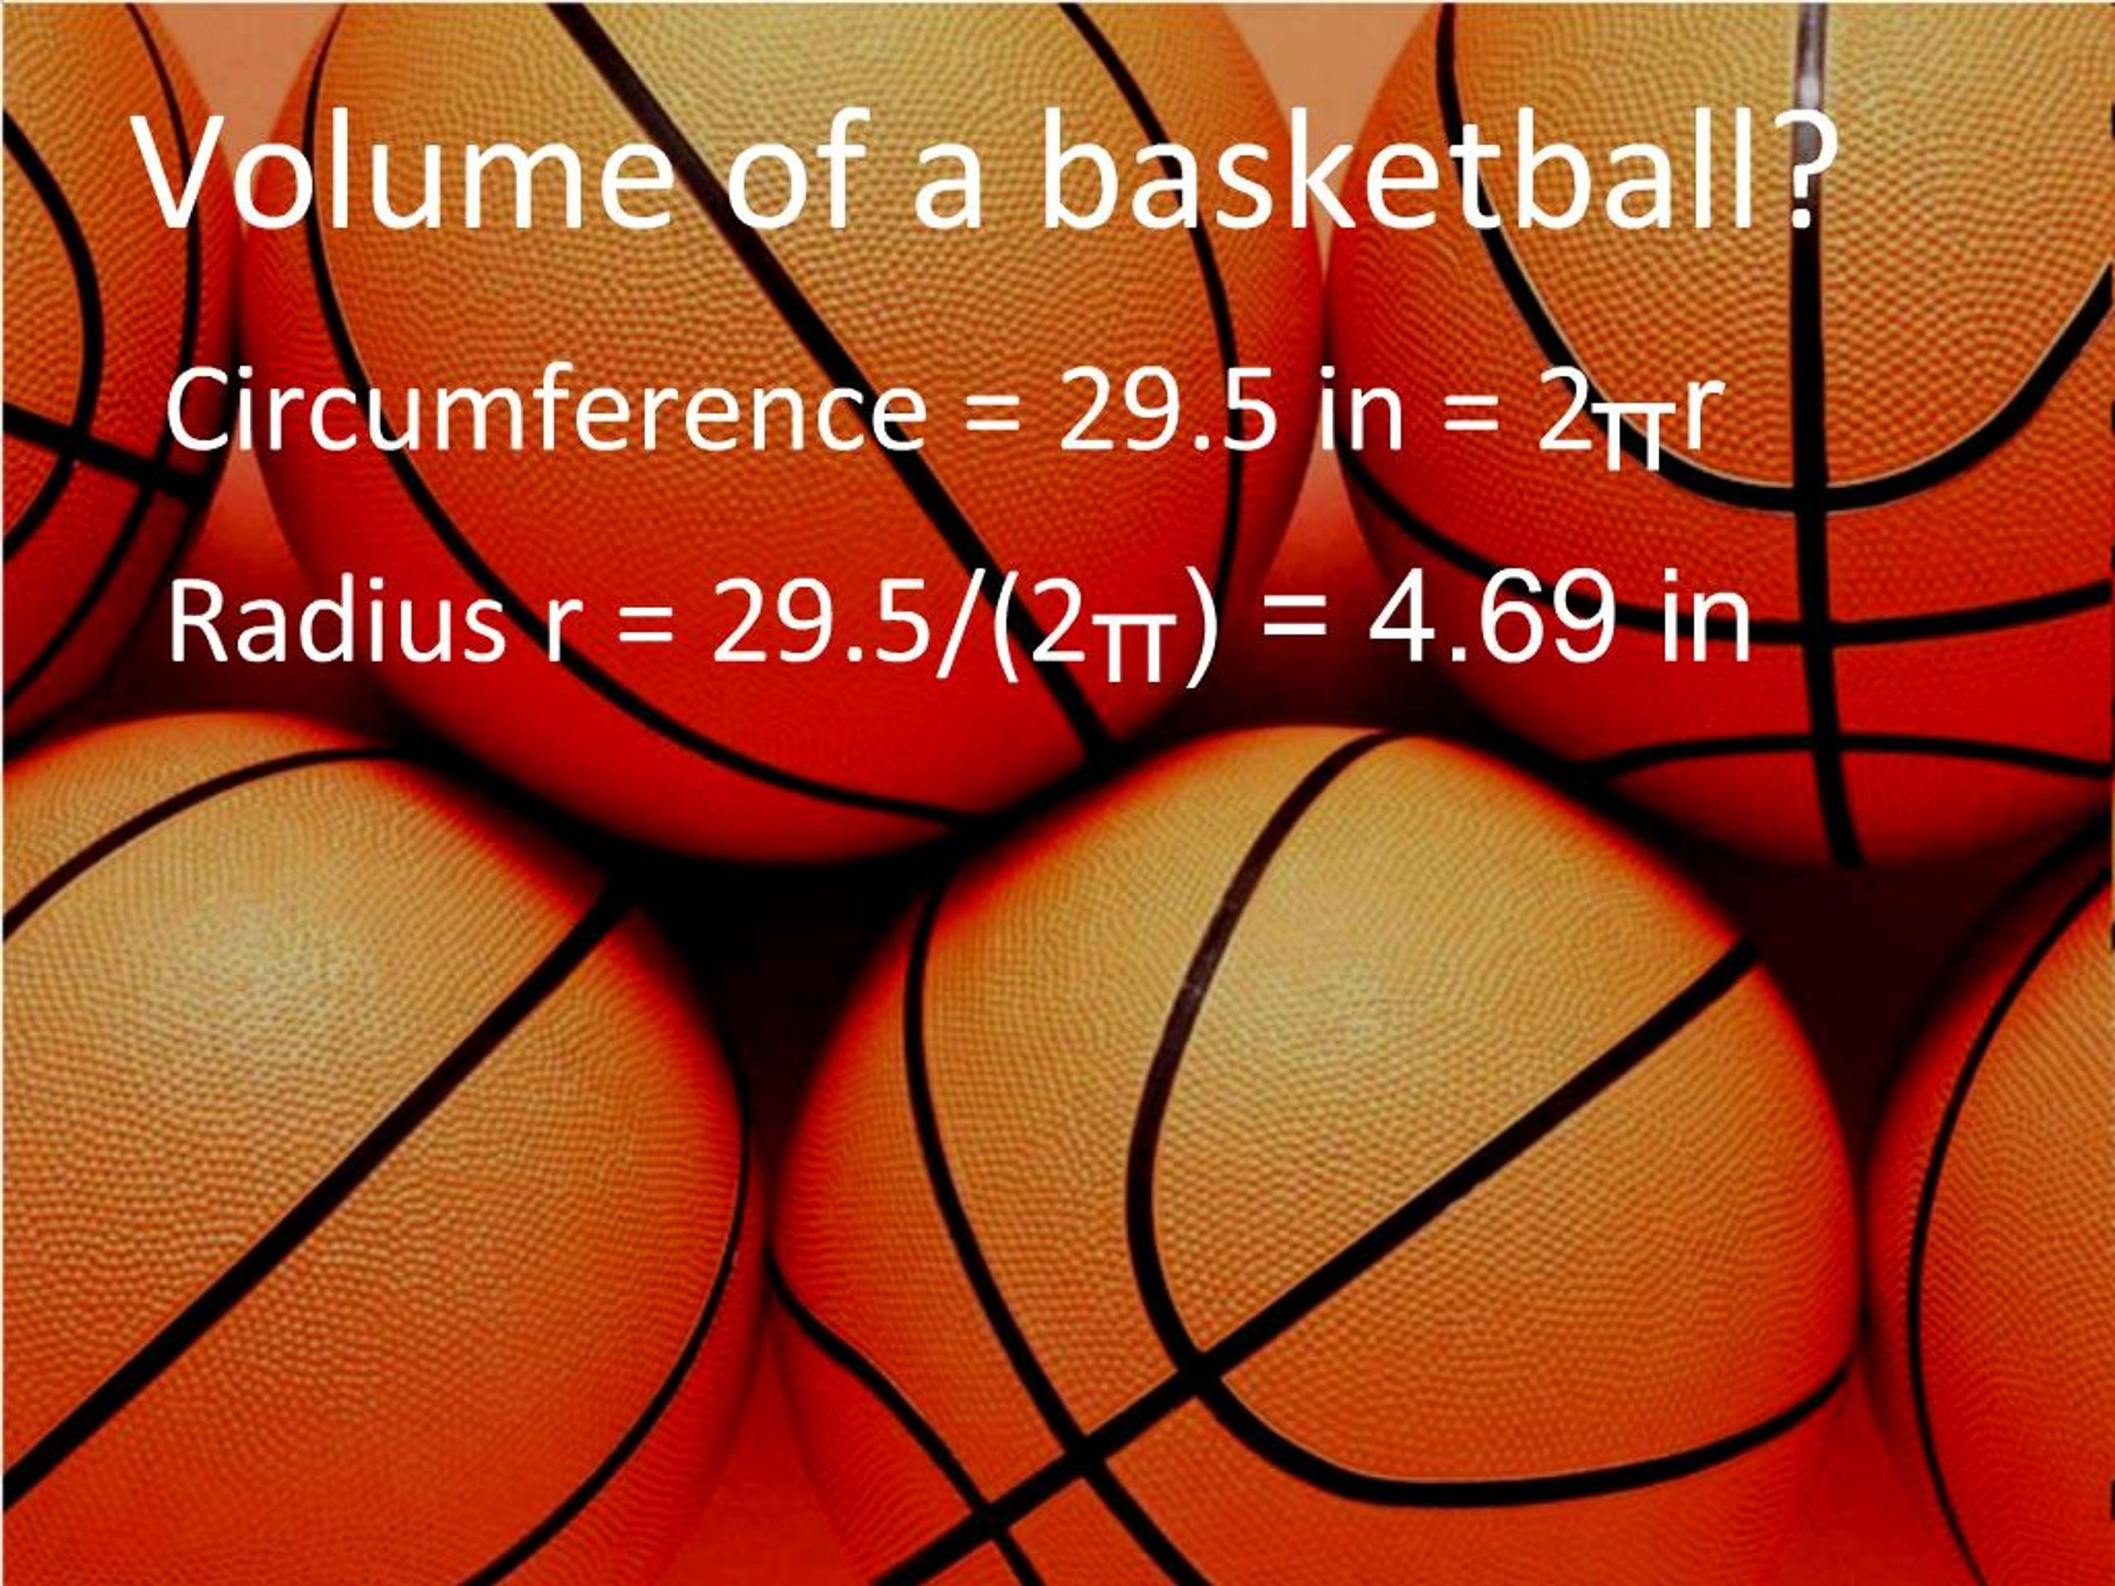

Slide 15
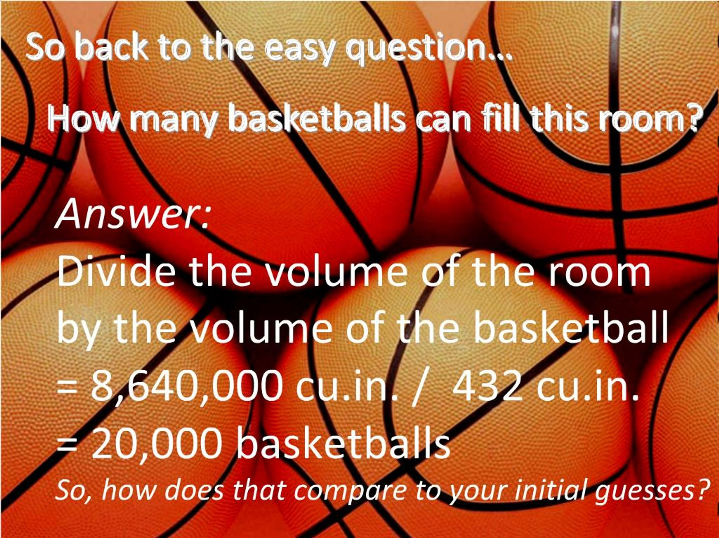

Slide 16


